Slide 1
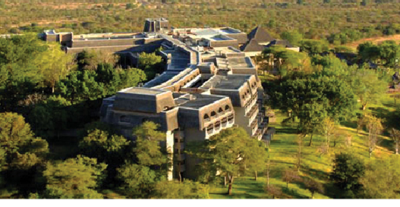
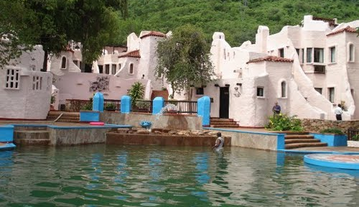

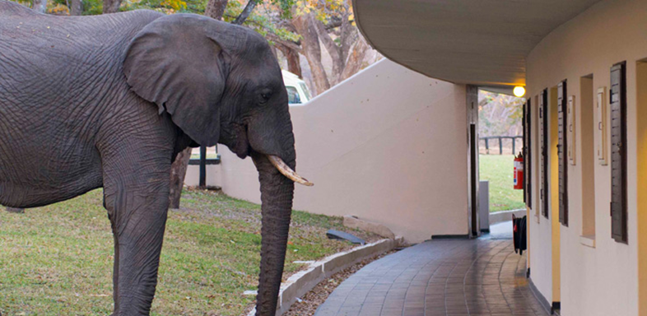
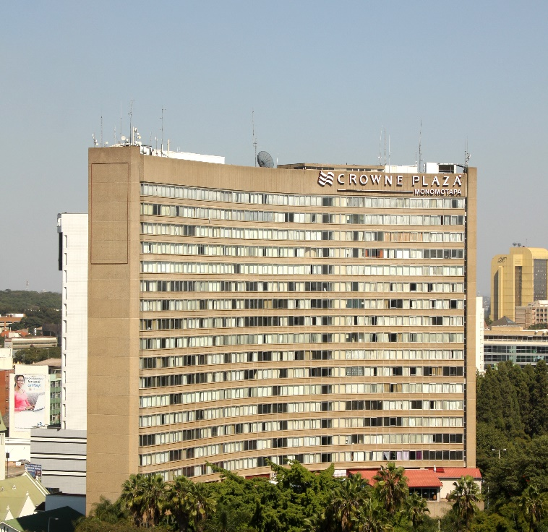
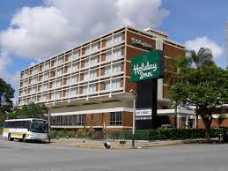
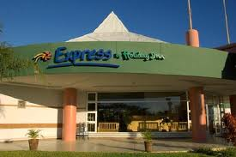

Elizabeth Windsor Gardens Brochure
January 2019

Slide 2
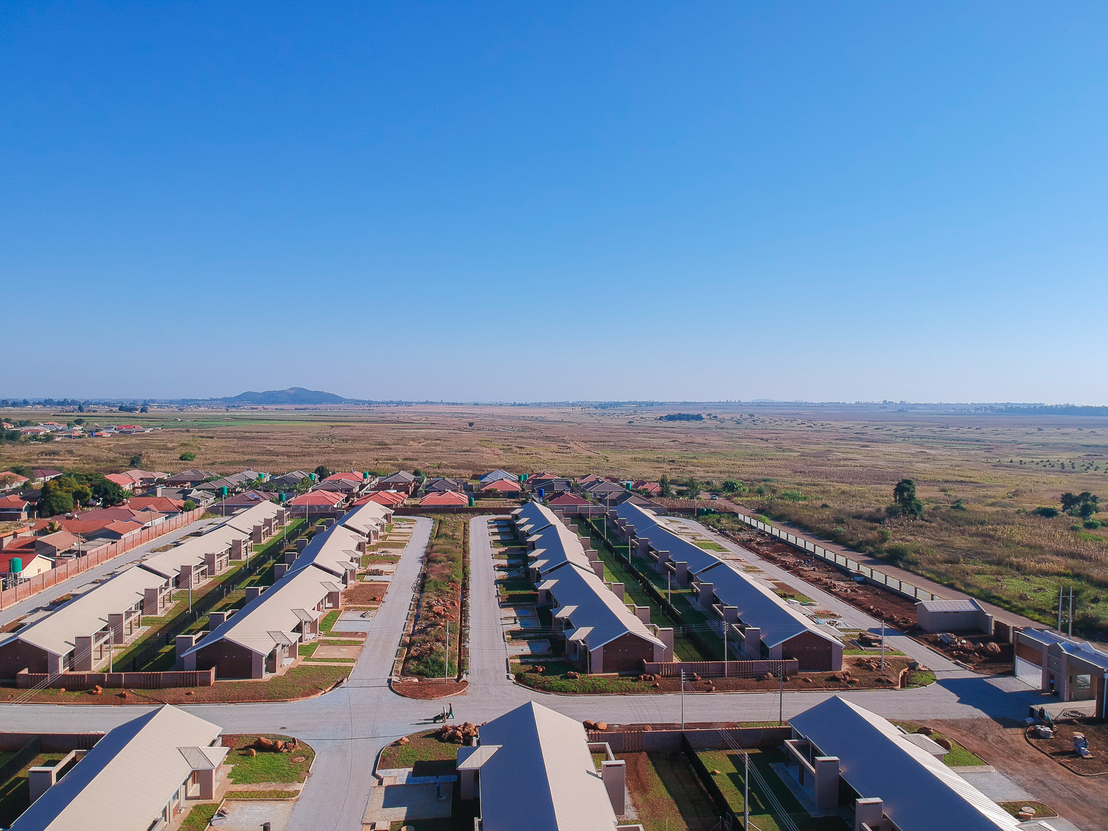
ELIZABETH WINDSOR
GARDENS

Slide 3
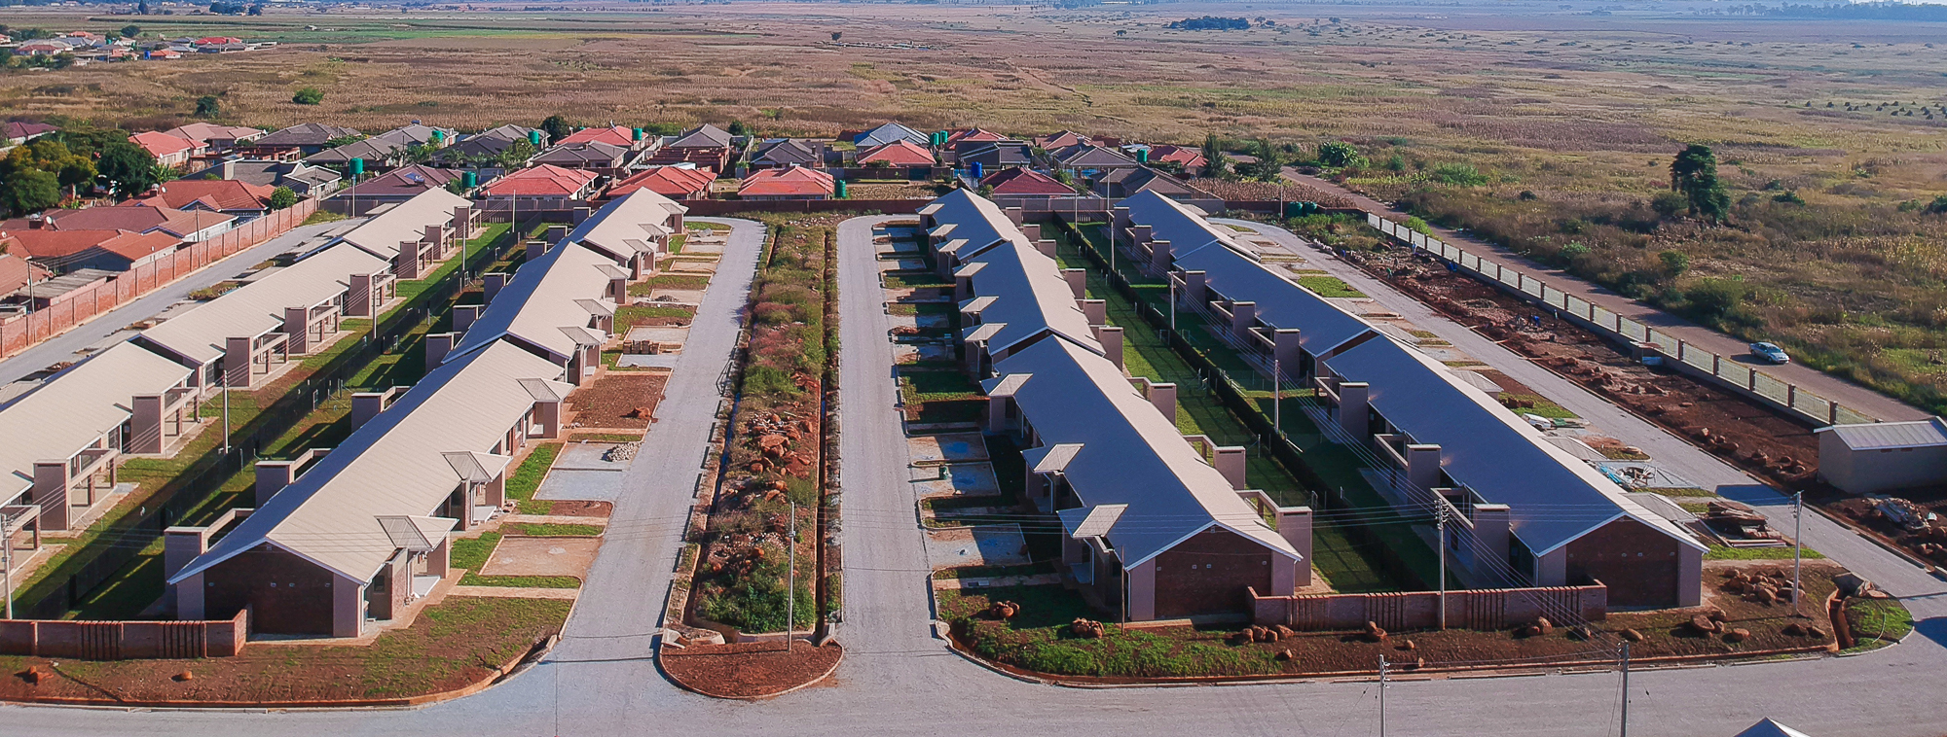
Elizabeth Windsor Gardens
Summary of the development
58 Units cluster development in Marlborough
12 X 2 Bed Units and 46 X 3 Bed Units
12km from the CBD and 3.9km from Westgate Shopping Centre
Current Selling Prices – 2 Bed US$115,000 and 3 Bed US$138,000 (including VAT). Prices exclude costs of Stamp Duty and Conveyancing (Conveyancing Lawyers - Mhishi Nkomo Legal)

Slide 4
Site Layout
Sold Units. Balance of Units unsold comprise 8 X 2 Beds and 15 X 3 Beds

Slide 5
2 Bed Floor Layout Plan
105 sq.m floor space

Slide 6
3 Bed Floor Layout Plan
139.3 sq.m floor space

Slide 7
Location and places of convenience

